Slide 1
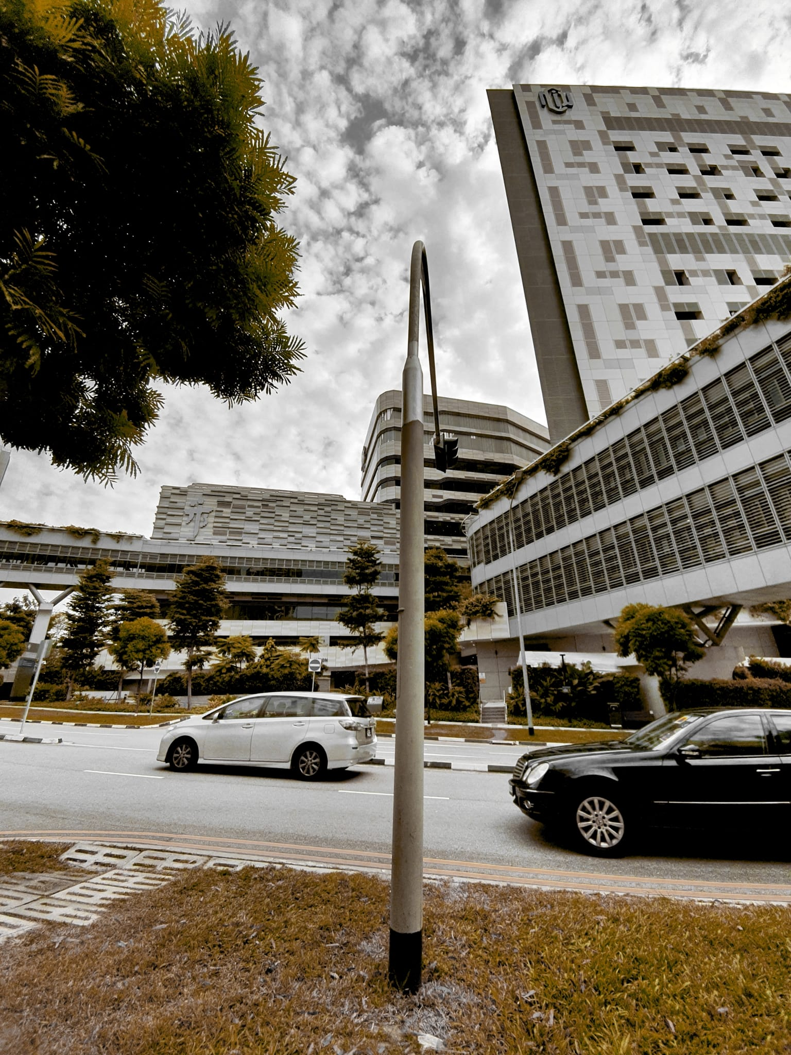
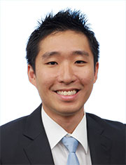
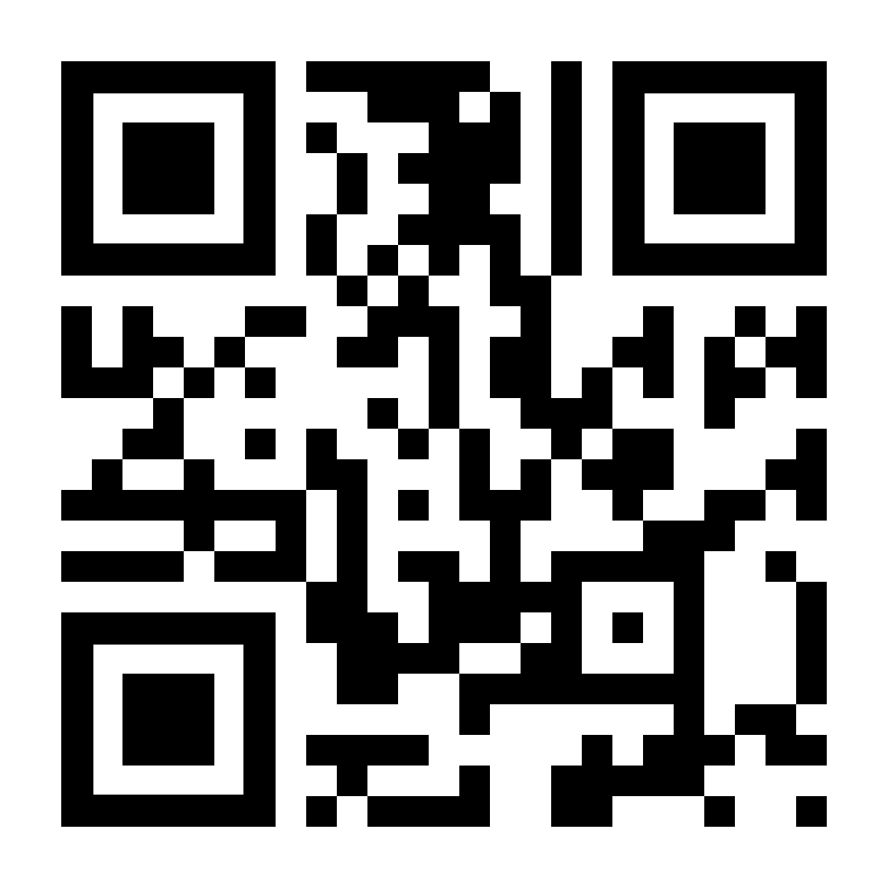
NATIONAL HEALTHCARE GROUP EYE INSTITUTE @ TTSH
LIVE
WEBINAR*
Cataract is the leading cause of reversible blindness and visual impairment globally. The only treatment for visually significant cataracts is cataract surgery, which is the most commonly performed eye surgery worldwide. How do patients know if they have cataracts? What are the surgical options? How does surgery improve vision? Come join us for our public forum to learn all about this common eye problem.
SATURDAY, 24 SEP 2022
10AM-11AM
DR JOHN WONG
CONSULTANT
NHG Eye Institute @ TTSH
REGISTRATION LINK
https://bit.ly/334wrI8
*Pre-registration is required for the live webinar. No registration fees required.
To register, please scan the QR Code from 22 August – 24 September 2022, and you will receive an email notification with the details.
For any enquiries, please contact eye@ttsh.com.sg.

