Slide 1
ALLIED HEALTH INTEGRATIVE NETWORK (AHINET)
Hybrid Workshop
LIVE WELL, STOP FALLS: PHYSIOTHERAPY ASSESSMENT AND MANAGEMENT OF FALLS IN OLDER ADULTS
14TH & 15TH SEPTEMBER 2023 | THURS & FRI | 1.00PM – 5.00PM
Globally, falls are a major public health problem. In Singapore, one in three community-dwelling elderly aged ≥ 65 years and one in two aged > 80 years will have at least one fall within a year. According to the SAFE (Steps to Avoid Falls in the Elderly) Study, falls account for 85% of all cases of elderly patients with trauma seen at the emergency department.
Falls can result in injuries, loss of confidence and a subsequent reduction in activity levels and community participation. The key to falls prevention is timely and accurate identification of risk factors and targeted evidence-based interventions to address falls risks. Effective interventions that can mitigate fall risk include targeted exercise prescription that incorporates adherence strategies. Falls also lead to a fear of falling again which can inhibit participation in physical activity and lead to further risk of falling. Fall prevention is vital in preventing the downward spiral of falls, preventing non-fallers from falling and recurrent fallers from falling again.
This workshop aims to equip physiotherapists from primary, tertiary and community settings with the core knowledge and skillset in evidence-based Physiotherapy assessment and management of falls prevention in older adults, providing opportunities for practical application.
Learning Objectives:
At the end of the workshop, participants would be able to:
Utilise relevant fall risk assessment tools and outcome measures to identify fall risk factors and stratify a patient’s fall risk
Develop an evidence-based physiotherapy intervention using principles of exercise prescription for falls prevention, including downstream referral to availability community resources and exercise programmes
Identify the barriers to exercises and use of principles of motivational interviewing to embrace behavior change
Target Audience:
Physiotherapists from primary, tertiary and community settings working with older adults
Speakers:
Ms. Joanne Yeo
Senior Physiotherapist
Ms. Natalie Yee
Senior Physiotherapist
Mr. Leuar Kok Hon
Psychologist
Course Fee:
SGD 450 (Early bird closing 20th July)
SGD 540 (Regular closing 17th Aug)
Platform:
Hybrid workshop
Day 1 will be conducted on site at Tan Tock Seng Hospital.
Day 2 will be conducted via
Zoom Cloud Meetings app.
Upon successful registration, you will receive the venue and zoom link for the virtual workshop closer to date.
Enquiries:
For enquiries please email:
AHInet@ttsh.com.sg
Registration:
Please register with
QR codes provided.
1

Slide 2
ALLIED HEALTH INTEGRATIVE NETWORK (AHINET)
PROGRAMME
14th SEPTEMBER 2023 (Thursday)
1300-1400 | Assessment of Risk Factors for Falls in Older Adults – Ms Natalie Yee
1400-1445 | Risk Stratification for Falls in Older Adults – Ms Natalie Yee
1445-1450 | BREAK
1450-1520 | Conducting of Outcome Measure [Practical]
1520-1530 | BREAK
1530-1630 | Application of Functional Assessment into Different Case Scenario [Group Activity]
1630-1700 | Applied Practice – Falls Risk Assessment
1700 | END
15th SEPTEMBER 2023 (Friday)
1300-1400 | Principles of Exercise Prescription for Fall Prevention in Older Adults – Ms Joanne Yeo
1400-1445 | Evidence-based Physiotherapy Intervention for Fall Prevention and Management in Older Adults – Ms Joanne Yeo
1445-1530 | Barriers to Exercise and Strategies to Improve Exercise Adherence – Mr Leuar Kok Hon
1530-1545 | BREAK
1545-1645 | Case Discussion on Fall Risk Assessment Tools and Evidence-Based Practices [Group Activity]
1645-1700 | Applied Practice – Implementing Falls Prevention Programme
1700 | END
Registration starts at 12.45pm.

Slide 3
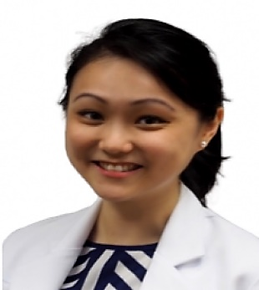
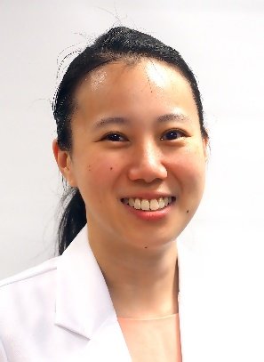
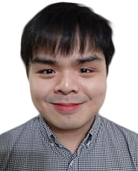
ALLIED HEALTH INTEGRATIVE NETWORK (AHINET)
SPEAKERS
MS. NATALIE YEE
Ms Natalie is a Senior Physiotherapist and has worked in Tan Tock Seng since 2010 and has specialised in geriatrics for the last 10 years. She has completed her post-graduate studies – Masters in Applied Gerontology from Flinders University. She has clinical experience in managing older adults across a range of settings, including inpatient, outpatient and in the community, including undertaking several projects that involve designing and running exercise classes for older people. Over the years, Ms Natalie was invited to speak at various community events to empower older people to remain physically active and conducted several workshops to other healthcare professionals on topics such as caring for and engaging older people. She has a keen interest in cognition and falls prevention and is a strong believer of person-centered care.
MS. JOANNE YEO
Ms Joanne is a Senior Physiotherapist and has worked in Tan Tock Seng Hospital since 2016. She has completed her degree studies – Bachelor of Science Physiotherapy from Curtin University (Australia). She has over 7 years of clinical experience and currently she specializes in the care of the geriatric population and has gained extensive exposure in both inpatient and outpatient setting. Her clinical interest includes working with older adults in the area of fall prevention and management and she is a strong advocate for person-centered care. She oversees FABFit, an exercise programme targeted at improving strength and balance for patients at the Centre of Geriatric Medicine, TTSH. Ms Joanne is also actively involved in taking junior staff and physiotherapy students in the field of geriatric rehabilitation.
MR. LEUAR KOK HON
Mr Kok Hon is a Clinical Neuropsychologist and has worked in Tan Tock Seng Hospital (TTSH) since 2020. He completed his post-graduate studies – Master of Psychology (Clinical Neuropsychology) from the University of Melbourne. Mr Kok Hon has clinical experience across a wide range of outpatient and inpatient settings at TTSH, including the Psychology clinic, Centre for Geriatric Medicine, and Clinic for Advanced Rehabilitation Therapeutics. His general work involves assisting in the assessment, diagnosis, and management of patients with brain and behaviour disorders.

